Slide 1
Amazon Connect Wisdom
Problem Statement
Solution
Agents invest a lot of time in researching answers from the pool of various web repositories.
Less customer satisfaction as issue resolution takes lot of time (CSAT Score falls)
Poor feedback leading to monetary loss to the organization.
Amazon Connect Wisdom leverages machine learning to cut down the time agents invest in researching answers.
Amazon Connect Wisdom uses real-time speech analytics and natural language processing (NLP) from Contact Lens for Amazon Connect to detect customer issues during calls.
Wisdom delivers real-time recommendations to agents.
Wisdom provides faster issue resolution and improved customer satisfaction.
Wisdom connects your knowledge repositories with built-in connectors for third-party applications including Salesforce and ServiceNow.

Slide 2
Underlying AWS Services
Amazon Connect
Amazon Contact Lens - Contact Lens for Amazon Connect enables you to analyse conversations between customer and agents, by using speech transcription, natural language processing, and intelligent search capabilities.
Amazon Connect Wisdom - Amazon Connect Wisdom delivers the agents the information they need by automatically detecting the issues and send real-time recommendations.
Amazon S3
AWS Lambda
Amazon Lex (only for chat)

Slide 3
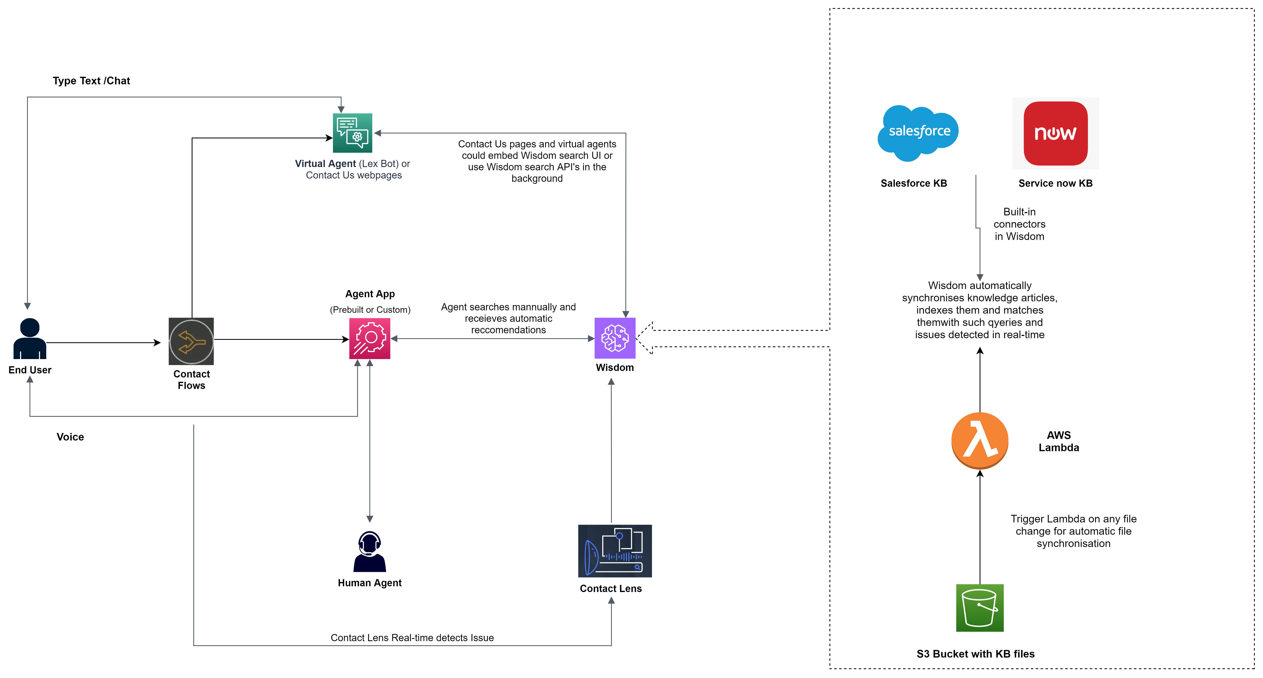
High Level Architecture

Slide 4
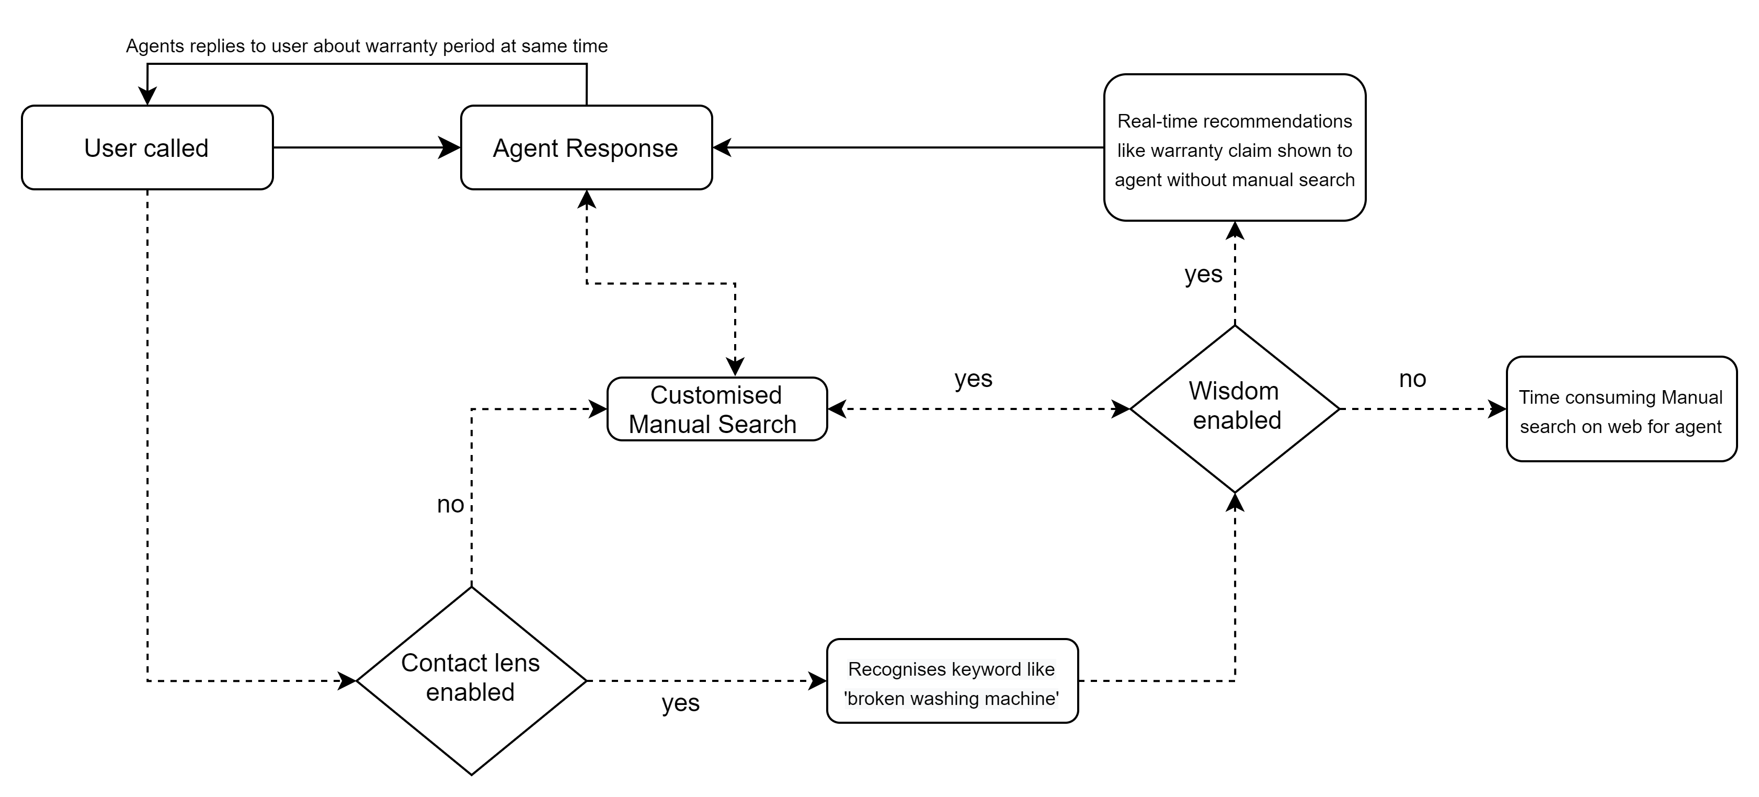
Scenario
Case: End User called CC with specific issue like broken product such as a washing machine.

Slide 5
Total Cost
Services | Cost
Amazon Connect per Agent | $222.6 per month
AWS Lambda per Agent | $0 per month ( with free tier) $8.53 per month (without free tier)
AWS S3 per Agent | $2.35 per month
Total
$224.95/month /Agent
$233.5/month /Agent
Assumptions:
No of agent =1
Average call time = 7 mins
No of calls per day = 20

Slide 6
Cost Breakdown
Amazon Connect
Factors | Value | Cost
Amazon Connect service usage charge | 7 min per call | $0.018 per min * 7 = $0.126
DID Number | German | $0.10 per day * 1 = $0.10
Inbound/Outbound Call per minute charge for German DID | 7 min per call | $0.004 * 7 = $0.028
Monthly charges |  | $95.6/month
Voice :
Factors | Value | Cost
No of messages ( Agent + Customer ) | 0 | $0.004 per message * 0 = $0.0
Chat :
Factors | Value | Cost
No of tasks | 1000 per month | $0.04 per task * 1000 = $40/month
Tasks :
Total Call Minutes analysed | Call – Tier 1 | Call – Tier 2 | Cost
4200 Min/month | $0.015/min for 5 million monthly minutes | $0.0125/min for 5 million+ monthly minutes | [4200*$0.015] = $63/month
Contact Lens :
Factors | Value | Cost
No of contacts/calls | 600 per month | $0.04 per task * 600 = $24/month
Wisdom:
Reference

Slide 7
Cost Breakdown
Amazon Lambda
Factors | Value | Unit
Memory Allocated | 512 | MB
Execution Duration | 1 | Sec
No of requests | <1 | Million
Factors | Calculations | Value | Cost(with free tier) | Cost(without free tier)
Computation | 1,000,000*512MB/1024 | 500,000 GB-s | $0 | $8.33
Requests | $0.20 per mil | 1 mil | $0 | $0.20
Total Cost |  |  | $0 | $8.53/month
Amazon S3
Factors | Value | Cost
S3 Size | 100GB | 100* 0.023 = $2.30
S3 Type | Standard | $0
No. Of Request | 10,000 | 10,000*0.000005 = $0.05
Total Cost |  | $2.35/month
LambdaReference
S3Reference

Slide 8
Effort Estimation
Resource number =4
Avg no of story points to be delivered by 1 resource in 20 MDs =5
Total story points to be delivered in 20MDs = 5*4 =20
Effort in time = 1.5 Months Approx.
Stage | Story point
Design & POC | 3
Documentation | 2
Development | 13
Testing | 13
Total Story points | 31

